Slide 1
Determination of food deserts in los angeles county
Steve Musiol
Ibm data science professional certificate capstone

Slide 2
INTRODUCTION
Food desert: areas where access to affordable, nutritious food is limited
Access could be:
Inadequate transportation
Inadequate income
No nearby market or grocery stores

Slide 3
INTRODUCTION (CONT’D)
Health problems associated with food deserts
Diabetes
Hypertension
Metabolic syndrome

Slide 4
BUSINESS PROBLEM
Los Angeles County has high unemployment and high income disparity
Can lead to food deserts
Increased food deserts may cause increased health problems
Strains budgets
Strains limited public health personnel

Slide 5
BUSINESS PROBLEM (CONT’D)
Identification of food deserts
Can improve permitting
Can help target tax incentives
Can improve investment and unemployment

Slide 6
DATA
Foursquare API for store locations
LA Almanac
Income by zip code
Population by zip code
LA Times
Geographic zip code boundaries

Slide 7
METHODOLOGY
Data ingestion
Machine learning via k-means clustering algorithm

Slide 8
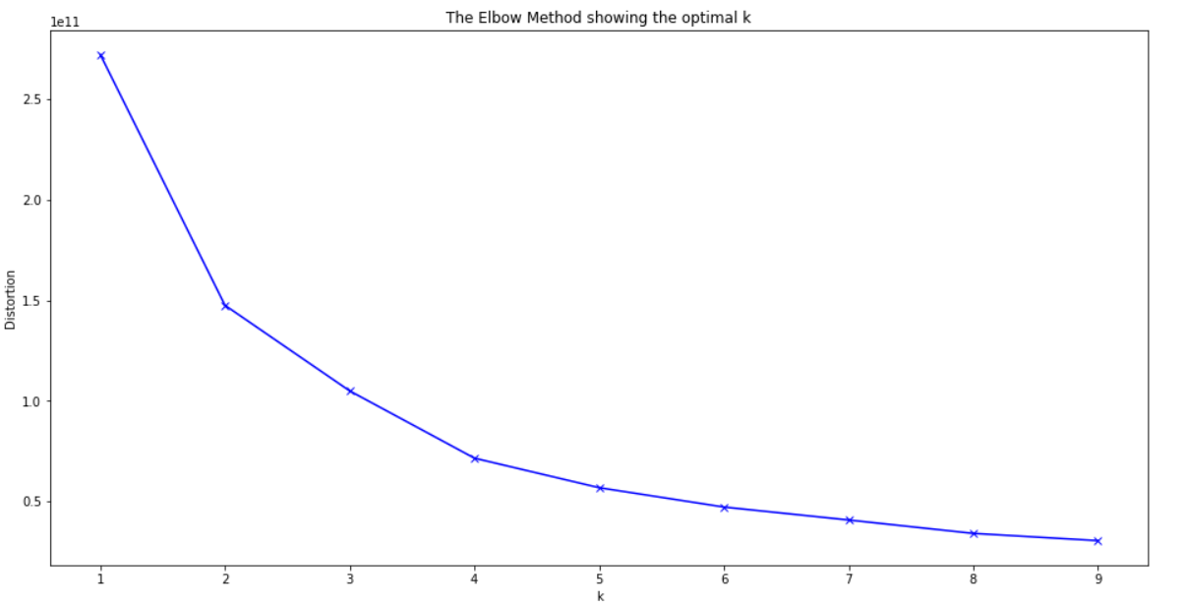
CLUSTER OPTIMIZATION

Slide 9


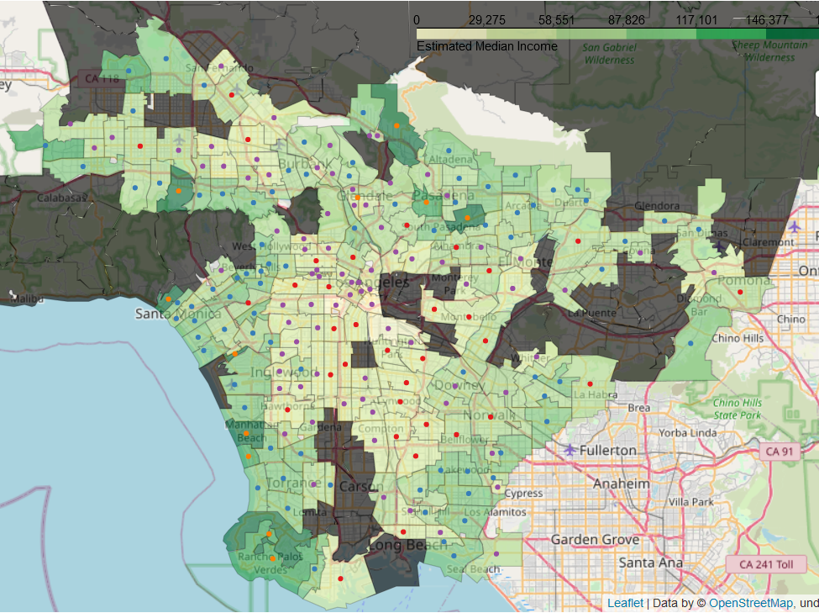
Map of counties BY INCOME AND CLUSTER

Slide 10
Cluster 1
Cluster 1
Zip Code | Qualifying Food Stores | Median Income | 2010 Population
90037 | 1 | 40,598 | 66,266
90011 | 1 | 49,675 | 62,180
90255 | 1 | 37,072 | 59,185
90022 | 1 | 40,940 | 103,892
90221 | 1 | 56,389 | 64,458

Slide 11
CLUSTER 2
Cluster 2
Zip Code | Qualifying Grocery Stores | Median Income | 2010 Population
90502 | 1 | 73,826 | 18,010
90604 | 1 | 74,944 | 39,407
91345 | 1 | 77,273 | 18,496
90605 | 1 | 78,297 | 40,331
90807 | 1 | 78,948 | 31,481

Slide 12
CLUSTER 3
Cluster 3
Zip Code | Qualifying Grocery Stores | Median Income | 2010 Population
91046 | 1 | 0 | 156
90058 | 1 | 21,964 | 3,223
91731 | 1 | 42,293 | 29,591
90008 | 1 | 43,364 | 32,327
90270 | 1 | 44,124 | 27,372

Slide 13
CLUSTER 4
Cluster 4
Zip Code | Qualifying Grocery Stores | Median Income | 2010 Population
91354 | 1 | 128,308 | 28,722
91105 | 1 | 131,158 | 11,254
90275 | 1 | 138,293 | 41,804
90094 | 1 | 155,417 | 5,464
91108 | 1 | 165,765 | 13,361

Slide 14
recommendations
Focus on Clusters 1 & 3
Cluster 1: zip code 90255
Cluster 3: zip code 90008
Recommendations based on lower median income, higher population, and fewer number of stores

